Slide 1



CCC (Cyber Competition Club)
Abdinasir Mumin, Abdul-Awwal Adesalu, Calvin Schmeichel, Joshua Bankers
Presenting: Image Capture Pose Mode

Slide 2

Intro
The problem:
It’s difficult for the user to take two photos from the same angle.
Our Solution:
Is to create a program using the React Native framework.
We will be able to use a smartphones camera to capture a "Before" photo.
Then use that photo to guide the user when taking the "After" Photo.

Slide 3
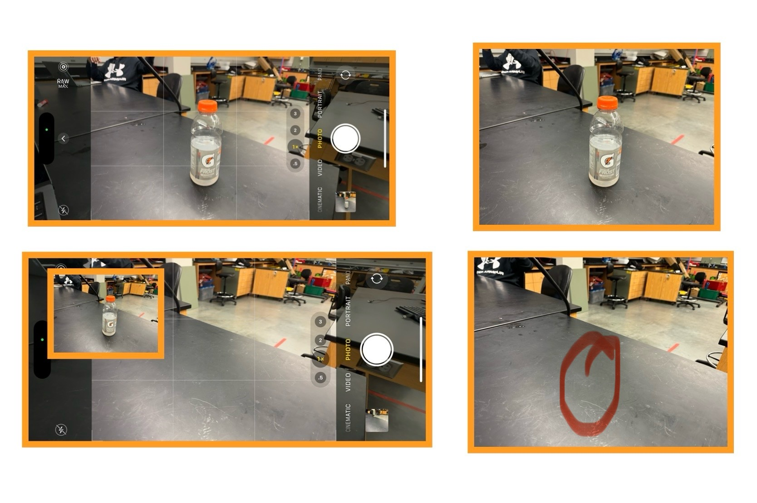
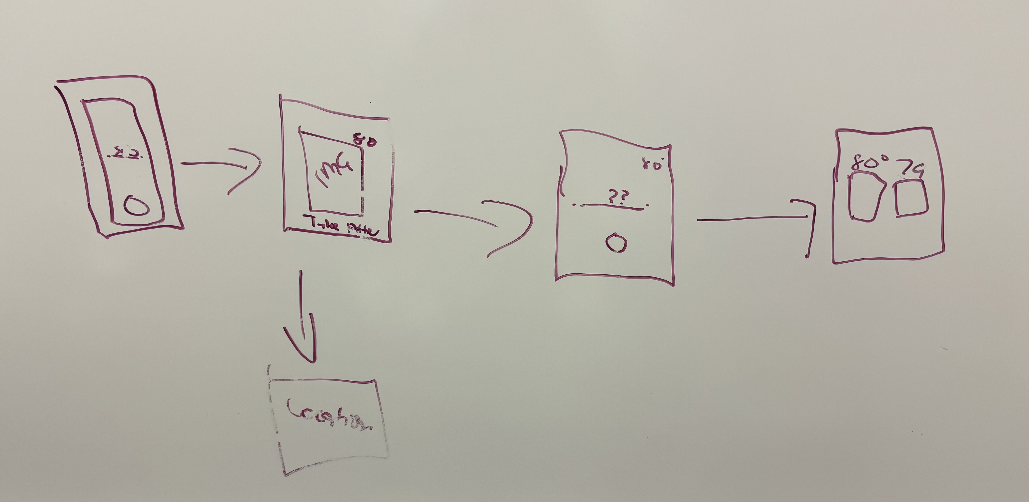
Our sketch's/Ideas

Slide 4
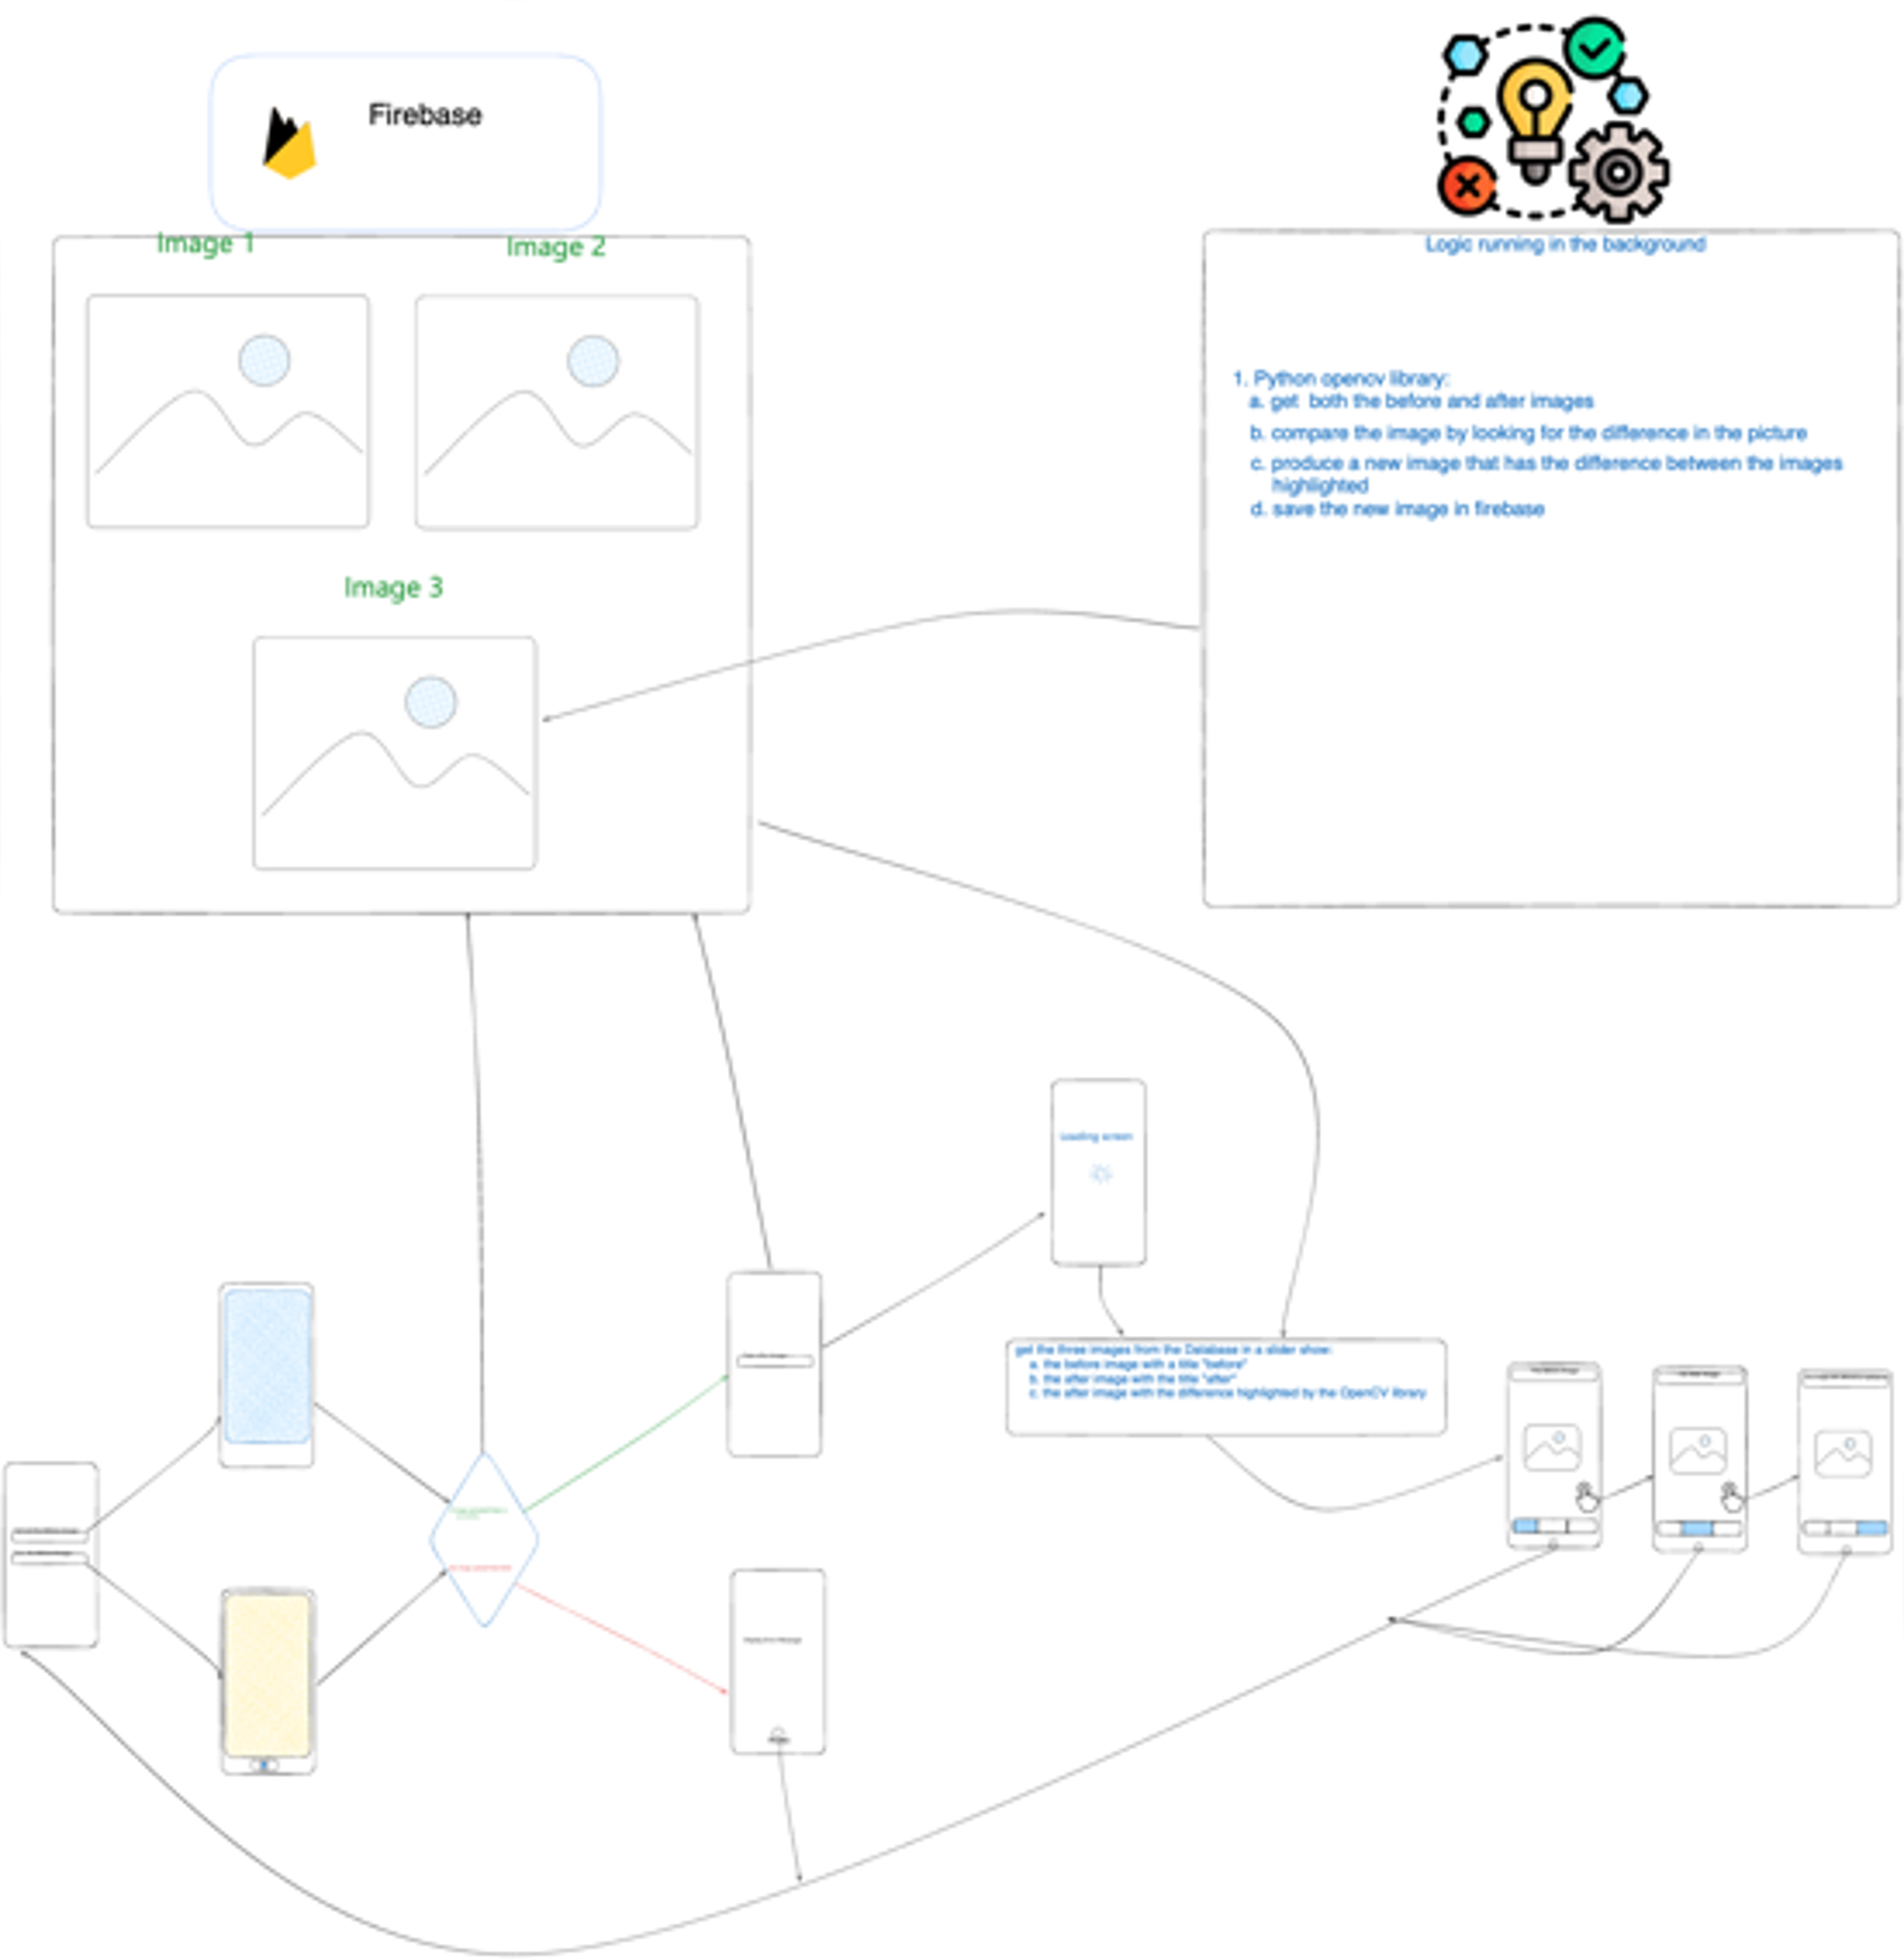
Sketch's/Ideas

Slide 5


Slide 10



Technologies
React Native
Python
Google Firebase

Slide 11
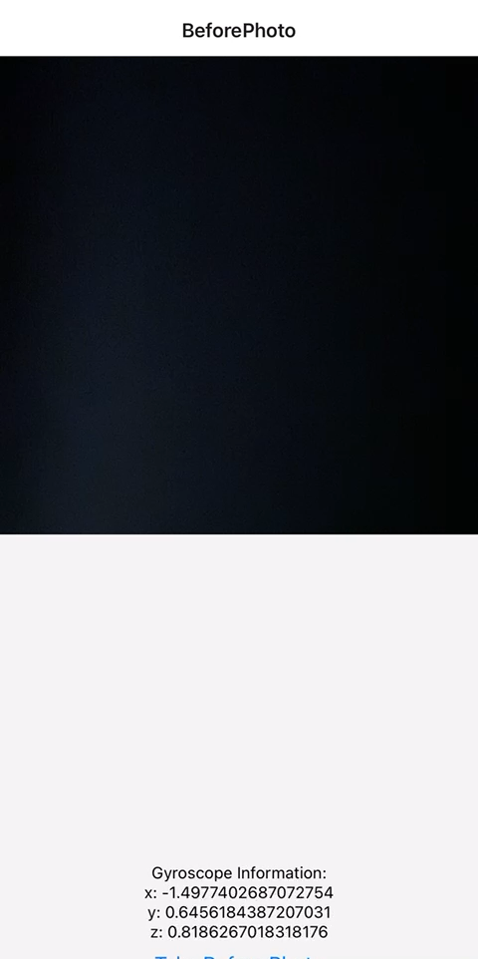
Front-End
Demo

Slide 12
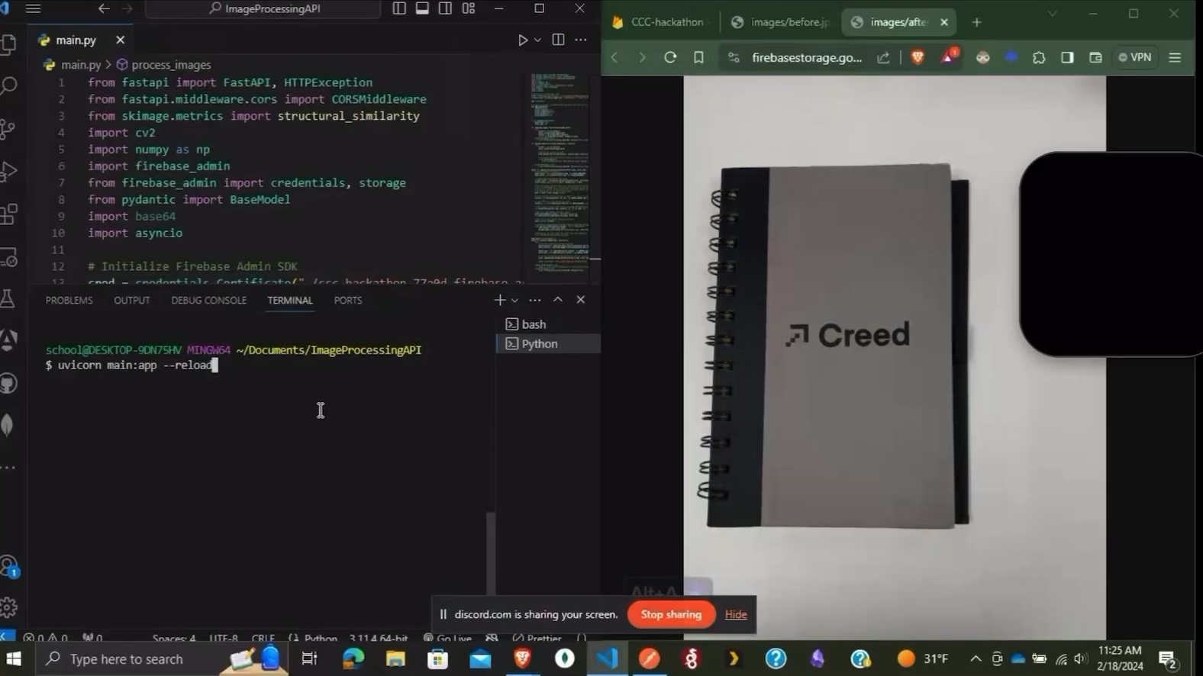
Final

Slide 13

Obstacles
Big Problem: Linking different technologies together.
Depreciated libraries.
Learning curve of using React Native for the first time.
Time

Slide 14

Looking Forward
Linking both front-end and back-end together.
Polishing front-end to make it easy to use and understand for the end user.

Slide 15
Questions?

